Slide 1


Australian Road Fatalities
Scyne advisory
Data Insights & Recommendations
Noorullah khan

Slide 2
Australian Road Fatalities
Scyne advisory
Data Insights & Recommendations
Noorullah khan

Slide 3
Executive SUMMARY
Fatal crashes have declined long-term but plateaued in recent years.
Weekends and late-night hours remain the highest-risk windows.
Young male drivers are disproportionately involved in fatal crashes.
Risks differ across environments: single-vehicle crashes dominate at high speed/night; multi-vehicle crashes peak in commuting hours.
Holiday periods mirror these risks, especially late-night driving, without adding new patterns.

Slide 4
Executive SUMMARY
Fatal crashes have declined long-term but plateaued in recent years.
Weekends and late-night hours remain the highest-risk windows.
Young male drivers are disproportionately involved in fatal crashes.
Risks differ across environments: single-vehicle crashes dominate at high speed/night; multi-vehicle crashes peak in commuting hours.
Holiday periods mirror these risks, especially late-night driving, without adding new patterns.

Slide 5
Executive SUMMARY
Fatal crashes have declined long-term but plateaued in recent years.
Weekends and late-night hours remain the highest-risk windows.
Young male drivers are disproportionately involved in fatal crashes.
Risks differ across environments: single-vehicle crashes dominate at high speed/night; multi-vehicle crashes peak in commuting hours.
Holiday periods mirror these risks, especially late-night driving, without adding new patterns.

Slide 6
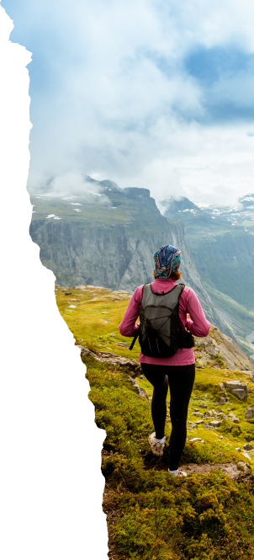
Marketing strategies
Implement personalized engagement strategies
Tailor campaigns to resonate with specific demographics, fostering a sense of relevance and connection
Collaborate with influencers and thought leaders to amplify our brand message

